Slide 1

Lead Time to Tender
By Amy Nestingen
https://github.com/nestingen/DSC-680-Lead-Time-to-Tender

Slide 2
Intro:
Lead time to tender is the amount of time between the time the truck is requested to the requested date of the pickup.
Mill Schedules Truck to Pick Up A Load
Date Mill Requested Truck for Pickup
$$$$
Time
Mill Schedules Truck to Pick Up A Load
Date Mill Requested Truck for Pickup
$
Time

Slide 3
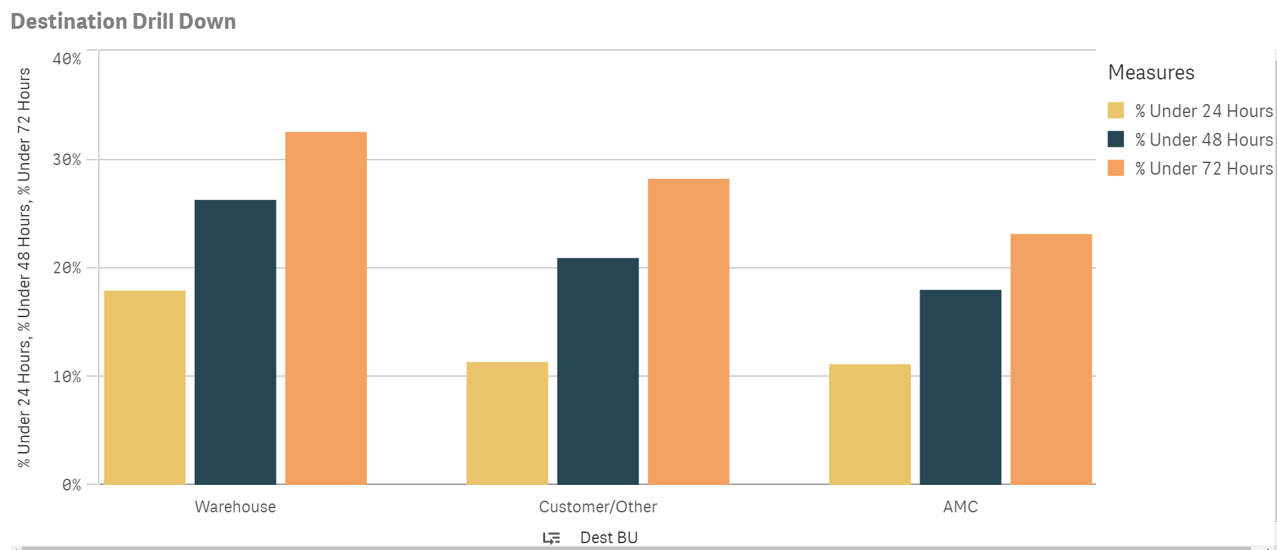
Analysis: Destination Business Unit Lead time to Tender Groups

Slide 4
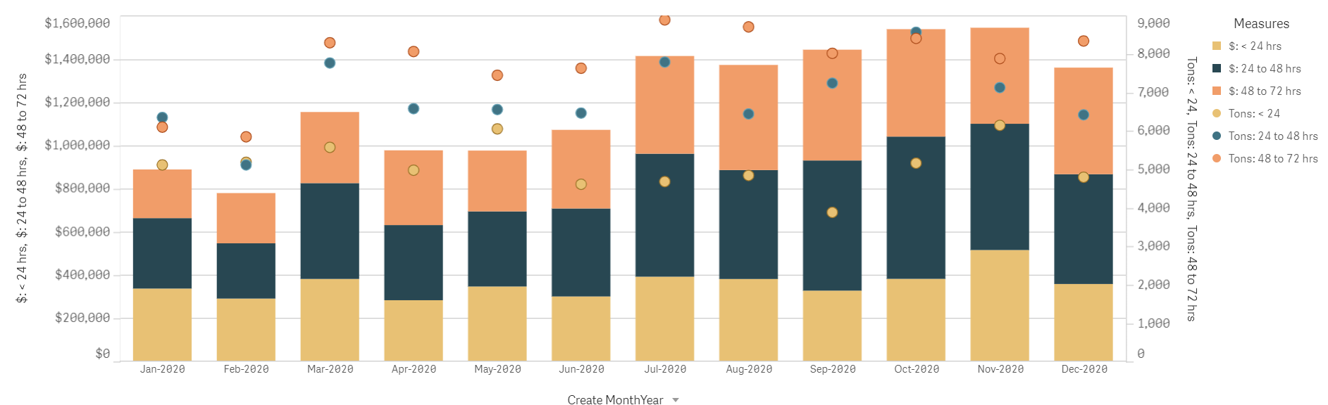
Analysis: Cost and Tons Shipped by Month and Lead Time

Slide 5
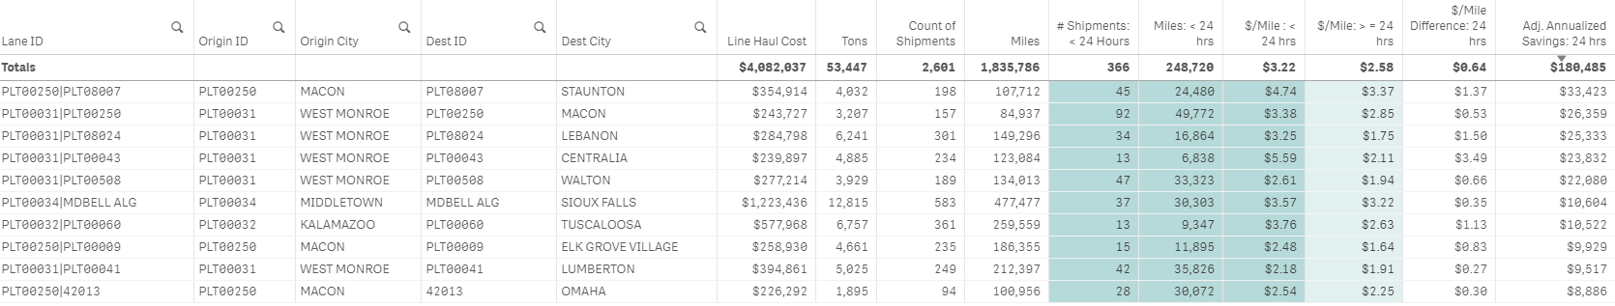
Model: Annualized Savings Table

Slide 6
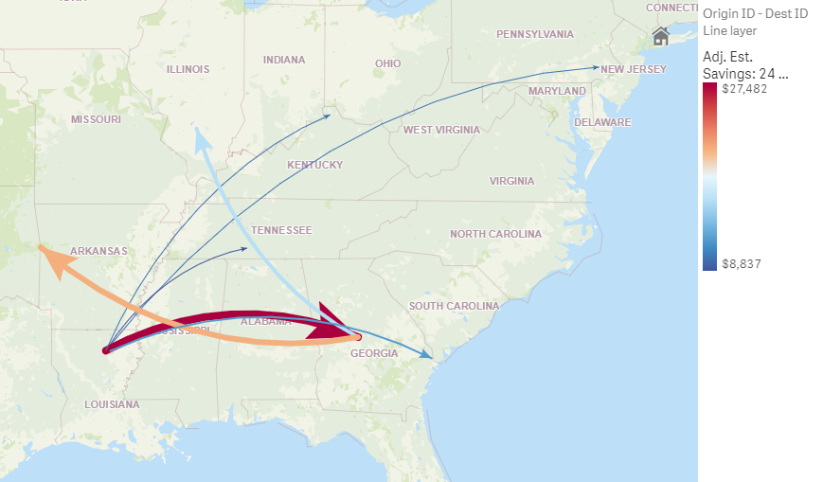
Model: Annualized Savings Map

